Slide 1
JAVASCRIPT FUNCTIONS

Slide 2
Functions
A function is a block of code that performs a specific task.
A function is executed when "something" invokes it (calls it).

Slide 3
Function Definition
A function definition (also called a function declaration, or function statement) consists of the function keyword, followed by:
The name of the function
A list of parameters
Statements to execute enclosed in curly brackets

Slide 4
Function Syntax:
function name(parameter) {
// code to be executed
}

Slide 5
Function Calling
Defining a function does not execute it.
Defining it names the function and specifies what to do when the function is called.
Calling the function actually performs the specified actions with the indicated parameters.

Slide 6
Function Return
When JavaScript reaches a return statement, the function will stop executing.
If the function was invoked from a statement, JavaScript will "return" to execute the code after the invoking statement.
Functions often compute a return value. The return value is "returned" back to the "caller":

Slide 7
Arrow Functions or Fat Functions
Normal function
function(params) {
//Your logic
}
Arrow function
(params) => {
//Your logic
}

Slide 8
Variable and Global scope
Variable Scope
1. Variables can be defined within or outside the scopes. For example, if the variables are defined within the code blocks then it is called local scope. And if they are outside code blocks then it is called the global code blocks. 2. Variable scope cannot be called outside of the code blocks and it will not work.
Global scope
1. Global scope can be changed into the code blocks with the help of the local scopes.
2. The best practice is to use the local scopes to avoid conflicts between applications.

Slide 9
Closure
Closure is a fundamental JavaScript concept and also closures are extremely powerful property of JavaScript
A closure is a combination of a function bundled together with references to its surrounding state(scopes).
In JavaScript, closures are defined as inner functions that have access to variables and parameters of outer function even after the outer function has returned. The below examples show the practical use of closures:

Slide 10
function counting() {
var balance = 1000;
function currentbalance() {
balance = balance - 10;
console.log("balance: ",balance)
}
currentbalance();
}

Slide 11
Function Hoisting
Hoisting is a concept which enables us to extract values of functions even before initializing/assigning value without getting error.
addno();
function addno(){
let no1=12;
let no2=12;
let result=no1+no2;
console.log(result);
}

Slide 12
Function Expression
A function expression has to be stored in a variable and can be accessed using variable Name.
let addno=function add(){
let no1=12;
let no2=12;
let result=no1+no2;
console.log(result);
}
addno();

Slide 13
Immediately Invoked Function Expression (IIFE)
Functions that are executed as soon as they are mounted.
(function sum(){
let no1=12;
let no2=12;
let result=no1+no2;
console.log(result);
} )();

Slide 14
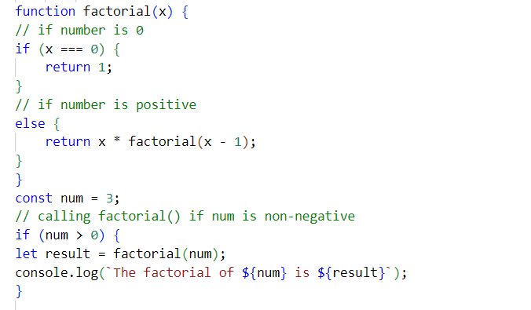
Function Recursion
Recursion is a process of calling itself. A function that calls itself is called a recursive function.

Slide 15
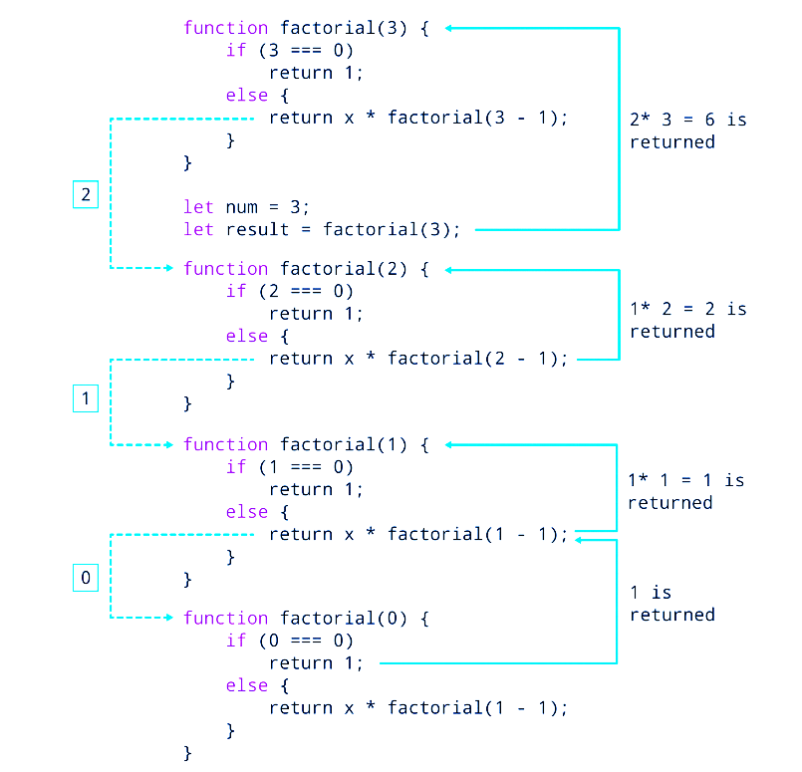
Working of Recursion

Slide 16
Pure Functions
Predictable
Readable
Reusable
testable

Slide 17
Disadvantages of java script functions:
* Code is always visible to everyone .
* Mutating the Inputs .
* Lack of Code standards .
* Java script is a browser specific language as it varies based on the browsers you use.
As different browsers have different java script engines.
For example - Google chrome uses v8 form engine
Mozilla uses spider monkey engine.

